Slide 1
NATURAL LANGUAGE PROCESSING

Slide 2
UNIT-II
N-gram Language Models: N-Grams, Evaluating Language Model, Sampling sentences from a language model, Sequence Labeling for Parts of Speech and Named Entities: Part-of-Speech Tagging, Named Entities and Named Entity Tagging

Slide 3
N-gram Language Modeling
Introduction to N-gram Language Models

Slide 4
Predicting words
The water of Walden Pond is beautifully ...
blue
green
clear
*refrigerator
*that

Slide 5
Language Models
Systems that can predict upcoming words
Can assign a probability to each potential next word
Can assign a probability to a whole sentence

Slide 6
Why word prediction?
It's a helpful part of language tasks
Grammar or spell checking
Their are two midterms Their There are two midterms
Everything has improve Everything has improve improved
Speech recognition
I will be back soonish I will be bassoon dish

Slide 7
Why word prediction?
It's how large language models (LLMs) work!
LLMs are trained to predict words
Left-to-right (autoregressive) LMs learn to predict next word
LLMs generate text by predicting words
By predicting the next word over and over again

Slide 8
Language Modeling (LM) more formally
Goal: compute the probability of a sentence or sequence of words W:
P(W) = P(w₁,w₂,w₃,w₄,w₅…w_{n})
Related task: probability of an upcoming word:
P(w₅|w₁,w₂,w₃,w₄) or P(w_{n}|w₁,w₂…w_{n-1})
An LM computes either of these:
P(W) or P(w_{n}|w₁,w₂…w_{n-1})

Slide 9
How to estimate these probabilities
Could we just count and divide?
No! Too many possible sentences!
We’ll never see enough data for estimating these
=

Slide 10
How to compute P(W) or P(w_{n}|w₁, …w_{n-1})
How to compute the joint probability P(W):
P(The, water, of, Walden, Pond, is, so, beautifully, blue)
Intuition: let’s rely on the Chain Rule of Probability

Slide 11
Reminder: The Chain Rule
Recall the definition of conditional probabilities
P(B|A) = P(A,B)/P(A) Rewriting: P(A,B) = P(A) P(B|A)
More variables:
P(A,B,C,D) = P(A) P(B|A) P(C|A,B) P(D|A,B,C)
The Chain Rule in General
P(x₁,x₂,x₃,…,x_{n}) = P(x₁)P(x₂|x₁)P(x₃|x₁,x₂)…P(x_{n}|x₁,…,x_{n-1})

Slide 12
The Chain Rule applied to compute joint probability of words in sentence
P(“The water of Walden Pond”) =
P(The) × P(water|The) × P(of|The water)
× P(Walden|The water of) × P(Pond|The water of Walden)

Slide 13
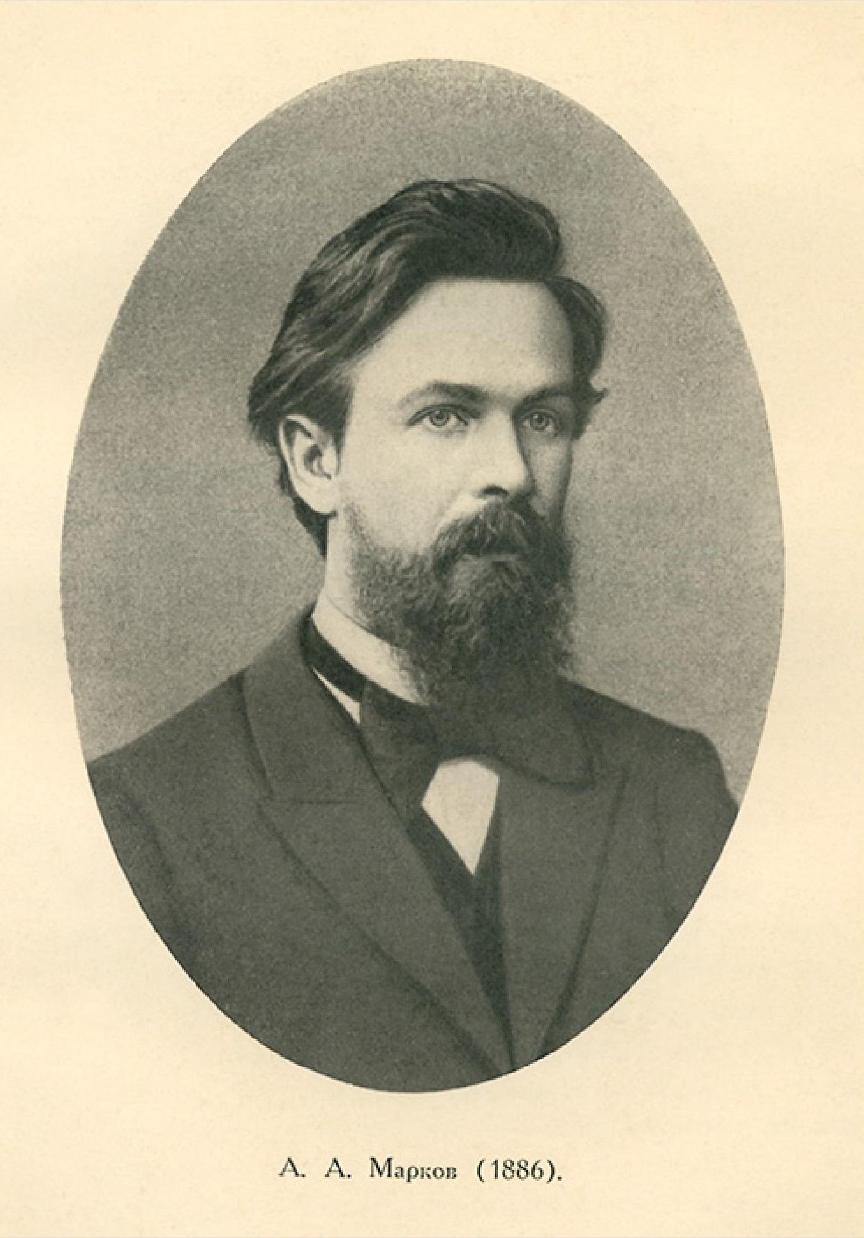
Markov Assumption
Simplifying assumption:
Andrei Markov
≈
Wikimedia commons

Slide 14
Bigram Markov Assumption
Instead of:
More generally, we approximate each component in the product

Slide 15
Simplest case: Unigram model
Some automatically generated sentences from two different unigram models
To him swallowed confess hear both . Which . Of save on trail for are ay device and rote life have
Hill he late speaks ; or ! a more to leg less first you enter
Months the my and issue of year foreign new exchange’s September
were recession exchange new endorsed a acquire to six executives

Slide 16
Bigram model
Some automatically generated sentences rom two different unigram models
Why dost stand forth thy canopy, forsooth; he is this palpable hit the King Henry. Live king. Follow.
What means, sir. I confess she? then all sorts, he is trim, captain.
Last December through the way to preserve the Hudson corporation N. B. E. C. Taylor would seem to complete the major central planners one gram point five percent of U. S. E. has already old M. X. corporation of living
on information such as more frequently fishing to keep her

Slide 17
Problems with N-gram models
N-grams can't handle long-distance dependencies:
“The soups that I made from that new cookbook I bought yesterday were amazingly delicious."
N-grams don't do well at modeling new sequences with similar meanings
The solution: Large language models
can handle much longer contexts
because of using embedding spaces, can model synonymy better, and generate better novel strings

Slide 18
Why N-gram models?
A nice clear paradigm that lets us introduce many of the important issues for large language models
training and test sets
the perplexity metric
sampling to generate sentences
ideas like interpolation and backoff

Slide 19
N-gram Language Modeling
Introduction to N-grams

Slide 20
N-Gram Models
P(office | about fifteen minutes from)
An N-gram model uses only N −1 words of prior context
Unigram: P(office)
Bigram: P(office | from)
Trigram: P(office | minutes from)
Markov model and Language Model An N-gram model is an N −1-order Markov Model
We can extend to trigrams, 4-grams, 5-grams ,N,,,,

Slide 21
In general, an insufficient model of language:
language has long-distance dependencies:
“The computer which I had just put into the machine room on the fifth floor crashed.”
In most of the applications, we can get away with N-gram models

Slide 22
Estimating N-grams probabilities
Maximum Likelihood Estimate
Value that makes the observed data the “most probable”
P(wi |wi−1) = count(wi−1,wi) /count(wi−1)
P(wi |wi−1) = count(wi−1,wi) /count(wi−1)
P(wi |wi−1) = c(wi−1,wi) /c(wi−1)

Slide 23
<S>I am here</S>
<S>who am I</S>
<S>I would like to know</S>

Slide 24
Estimating bigrams
P(I|) =
P(|here) =
P(would | I) =
P(here | am) =
P(know | like) =

Slide 25
N-gram Language Modeling
Estimating N-gram Probabilities

Slide 26
Estimating bigram probabilities
The Maximum Likelihood Estimate

Slide 27
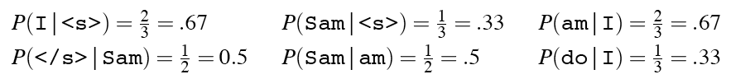
An example
<s> I am Sam </s>
<s> Sam I am </s>
<s> I do not like green eggs and ham </s>

Slide 28
More examples: Berkeley Restaurant Project sentences
can you tell me about any good cantonese restaurants close by
tell me about chez panisse
i’m looking for a good place to eat breakfast
when is caffe venezia open during the day

Slide 29
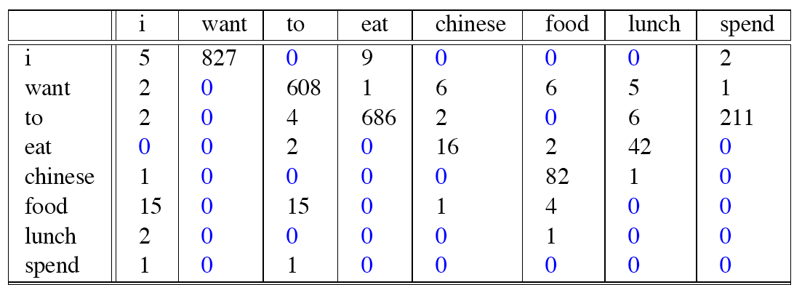
Raw bigram counts
Out of 9222 sentences

Slide 30
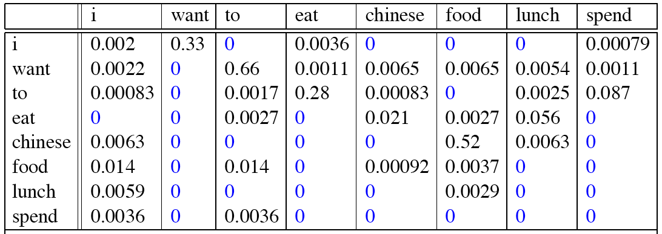
Raw bigram probabilities
Normalize by unigrams:
Result:

Slide 31
Bigram estimates of sentence probabilities
P(<s> I want english food </s>) =
P(I|<s>)
× P(want|I)
× P(english|want)
× P(food|english)
× P(</s>|food)
= .000031

Slide 32
What kinds of knowledge do N-grams represent?
P(english|want) = .0011
P(chinese|want) = .0065
P(to|want) = .66
P(eat | to) = .28
P(food | to) = 0
P(want | spend) = 0
P (i | <s>) = .25

Slide 33
Dealing with scale in large n-grams
LM probabilities are stored and computed in log format, i.e. log probabilities
This avoids underflow from multiplying many small numbers
If we need probabilities we can do one exp at the end

Slide 34
Larger ngrams
4-grams, 5-grams
Large datasets of large n-grams have been released
N-grams from Corpus of Contemporary American English (COCA) 1 billion words (Davies 2020)
Google Web 5-grams (Franz and Brants 2006) 1 trillion words)
Efficiency: quantize probabilities to 4-8 bits instead of 8-byte float
Newest model: infini-grams (∞-grams) (Liu et al 2024)
No precomputing! Instead, store 5 trillion words of web text in suffix arrays. Can compute n-gram probabilities with any n!

Slide 35
N-gram LM Toolkits
SRILM
http://www.speech.sri.com/projects/srilm/
KenLM
https://kheafield.com/code/kenlm/

Slide 36
N-gram Language Modeling
Estimating N-gram Probabilities

Slide 37
Language Modeling
Evaluation and Perplexity
Notes:
Language models, like all NLP tools, need to be evaluated. Here we introduce the standard evaluation tools for ngram language models as well as large language models: training sets, test sets, and the perplexity metric.

Slide 38
How to evaluate N-gram models
"Extrinsic (in-vivo) Evaluation"
To compare models A and B
Put each model in a real task
Machine Translation, speech recognition, etc.
Run the task, get a score for A and for B
How many words translated correctly
How many words transcribed correctly
Compare accuracy for A and B
Notes:
The best way to evaluate any NLP component like an N-gram language model is called extrinsic or in-vivo evaluation, meaning a live or real application. If we have two models, A, and B, that we want to evaluate, we put each in a real task that we care about, run the task, get a score for each of the two language models, such as the number of words translated or transcribed correctly, and then we just compare the scores or accuracies.

Slide 39
Intrinsic (in-vitro) evaluation
Extrinsic evaluation not always possible
Expensive, time-consuming
Doesn't always generalize to other applications
Intrinsic evaluation: perplexity
Directly measures language model performance at predicting words.
Doesn't necessarily correspond with real application performance
But gives us a single general metric for language models
Useful for large language models (LLMs) as well as n-grams
Notes:
Extrinsic evaluation isn't always possible. It's often time-consuming and expensive to run real tasks, involving human scoring, but that's a problem because we often want to evaluate thousands of versions of our systems. Also, we might want to see how well our n-gram language model works more generally, and not just in a particular application. For this reason, we often use an intrinsic, or in-vitro evaluation metric called perplexity. We call it intrinsic or in-vitro because it's not embedded in a real application in the world, so it's sort of a test-tube evaluation. Perplexity directly measuring language model performance at predicting words. This may not always correspond with real application performance, but it gives us a single general metric. We use perplexity for simple n-gram language models but also for the most advanced neural Large Language Models.

Slide 40
Training sets and test sets
We train parameters of our model on a training set.
We test the model’s performance on data we haven’t seen.
A test set is an unseen dataset; different from training set.
Intuition: we want to measure generalization to unseen data
An evaluation metric (like perplexity) tells us how well our model does on the test set.
Notes:
To evaluate, we'll need some data. We always train the parameters of our model, like the n-gram counts, on a training set. And we test the model's performance on data we haven't seen. A test set is an unseen dataset that is different from our training set, no part of it should have been used in training. The intuition is that we care about generalization of our model. A machine learning model that perfectly captured the training data, but doesn't generalize well to unseen data, wouldn't be much use! And then we'll need an evaluation metric, like perplexity, that tells us how well our model does on the test set.

Slide 41
Choosing training and test sets
If we're building an LM for a specific task
The test set should reflect the task language we want to use the model for
If we're building a general-purpose model
We'll need lots of different kinds of training data
We don't want the training set or the test set to be just from one domain or author or language.
Notes:
How do we create a training set? Sometimes we're building an LM for a specific task, like legal language or medical language, and then the test set should reflect the task that we care about. Other times, we're building a general-purpose language model, and then we'll want to make sure we get balanced data from lots of different genres and authors. And of course lots of data from many different languages, if we're building a multilingual LM.

Slide 42
Training on the test set
We can’t allow test sentences into the training set
Or else the LM will assign that sentence an artificially high probability when we see it in the test set
And hence assign the whole test set a falsely high probability.
Making the LM look better than it really is
This is called “Training on the test set”
Bad science!
Notes:
Again, the test set and the training set must be non-overlapping. If we have a test sentence in the training set, the n-gram (or any other language model) will learn which words follow which words in that sentence, and then when we see it in the test set, we will assign it a very probabilkity, and that will falsely make the language model seem more accurate than it is. Training on the test set is always a bad idea. It seems obvious, but it requires a lot of dataset care to keep this from happening, since often we get duplicate documents in our dataset, and one might find its way into the training set, and one into the test set.

Slide 43
Dev sets
If we test on the test set many times we might implicitly tune to its characteristics
Noticing which changes make the model better.
So we run on the test set only once, or a few times
That means we need a third dataset:
A development test set or, devset.
We test our LM on the devset until the very end
And then test our LM on the test set once
Notes:
Even a test set isn't enough. If we keep adjusting our LM, re-testing it on the same test set, we will implicitly be tuning it to the test set, improving it in ways that are fit too exactly to that particularly test set. So we try to reserve the test set to just run once or twice. Thus we'll need an intermediate test set to use while we are developing. That test set is hence called the development testset or devset.

Slide 44
Intuition of perplexity as evaluation metric: How good is our language model?
Intuition: A good LM prefers "real" sentences
Assign higher probability to “real” or “frequently observed” sentences
Assigns lower probability to “word salad” or “rarely observed” sentences?
Notes:
Let's now turn to the perplexity metric. The intuition of perplexity is that a good language model should prefer reall, or frequently observed sentences, and assign lower probably to rarely observed sentences, or just random sequences of words that we might call "word salad".

Slide 45
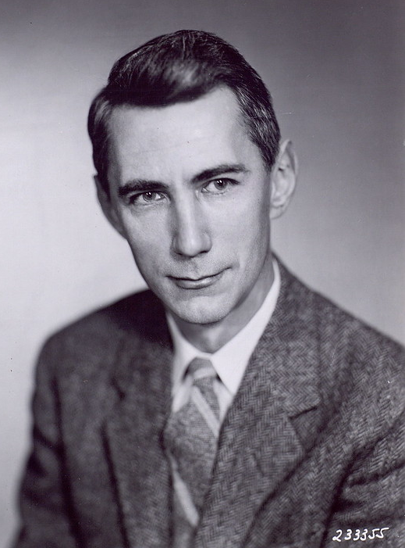
Intuition of perplexity 2: Predicting upcoming words
time 0.9
dream 0.03
midnight 0.02
…
and 1e-100
The Shannon Game: How well can we predict the next word?
Once upon a ____
That is a picture of a ____
For breakfast I ate my usual ____
Unigrams are terrible at this game (Why?)
Claude Shannon
A good LM is one that assigns a higher probability to the next word that actually occurs
Picture credit: Historiska bildsamlingen
https://creativecommons.org/licenses/by/2.0/
Notes:
We can think of this predicting task first just for individual words. The idea of asking an LM, or a person, to look at the start of a sentence, and predict the next upcoming word is called the Shannon Game, because it was invented by information theorist Claude Shannon in 1951 as a way of measuring the entropy of English. So if we see the prefix "Once upon a", we might guess "time" as a very likely next word, and maybe we would assign dream, or midnight as possible but less likely, while words like "and" should be extremely unlikely, because "Once upon a and" is an unlikely sentence. People are pretty good at this, as are language models, the longer the better. Unigrams are terrible at this time. Think about why this is? intuition of perplexity is that a good LM is one that is good at the Shannon game: it assigns a higher probability to the next word that actually occurs

Slide 46
Intuition of perplexity 3: The best language model is one that best predicts the entire unseen test set
We said: a good LM is one that assigns a higher probability to the next word that actually occurs.
Let's generalize to all the words!
The best LM assigns high probability to the entire test set.
When comparing two LMs, A and B
We compute P_{A}(test set) and P_{B}(test set)
The better LM will give a higher probability to (=be less surprised by) the test set than the other LM.
Notes:
Let's generalize this idea that a good LM assigns a higher probability to the next word that actually occurs, to say that A good LM assigns high probability to the entire test set. Let's just think of the test set as if it was one very long sentence. So when comparing to LMs, A, and B, we ask each to tell us the probability of the entire testset. Now the better LM is the one that gives a higher probability to the test set, or in other words is less surprised by the test set than the other LM.

Slide 47
Intuition of perplexity 4: Use perplexity instead of raw probability
Probability depends on size of test set
Probability gets smaller the longer the text
Better: a metric that is per-word, normalized by length
Perplexity is the inverse probability of the test set, normalized by the number of words
Notes:
There's a problem with using probability. And that is that the probability of a test set depends very directly on the length of the test set. This is because probability gets smaller the longer the text. For n-gram models, this is very clear; the chain rule of probability means that for a test set of N words we are multiplying together N n-gram probabilities! It would be better to normalize the probabilities by length to get a metric that is per-word. Perplexity is just such a metric. Perplexity is the inverse probability of the test set, normalized by the number of words. We normalize by taking the N-th root of the probability of the test set.

Slide 48
Intuition of perplexity 5: the inverse
Perplexity is the inverse probability of the test set, normalized by the number of words
(The inverse comes from the original definition of perplexity from cross-entropy rate in information theory)
Probability range is [0,1], perplexity range is [1,∞]
Minimizing perplexity is the same as maximizing probability
Notes:
Notice that I slipped something in there. Perplexity isjust just the probability of the test set normalized by the number of words. It's the inverse probability. There is this little minus-sign here, or a 1/x here. This inverse turns out to come from part of the original definition of perplexity from the idea of cross-entropy rate in information theory. We won't go into that here, but you can look at it in the textbook). We'll just say that because of that inverse, minimizing perplexity is the same as maximizing probability. So the better LM has a higher probability but a lower perplexity on the test set.

Slide 49
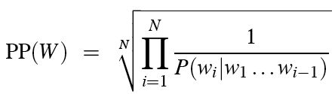
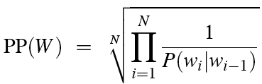
Intuition of perplexity 6: N-grams
Chain rule:
Bigrams:
Notes:
Let's see perplexity with n-gram language models. We can use the chain rule to turn the probability of the entire test set into N separate probabilities. Now we can make the n-gram assumption, such as the bigram simplification, to help us compute each of these individual probabilities.

Slide 50
Intuition of perplexity 7: Weighted average branching factor
Perplexity is also the weighted average branching factor of a language.
Branching factor: number of possible next words that can follow any word
Example: Deterministic language L = {red,blue, green}
Branching factor = 3 (any word can be followed by red, blue, green)
Now assume LM A where each word follows any other word with equal probability ⅓
Given a test set T = "red red red red blue"
Perplexity_{A}(T) = P_{A}(red red red red blue)^{-1/5} =
But now suppose red was very likely in training set, such that for LM B:
P(red) = .8 p(green) = .1 p(blue) = .1
We would expect the probability to be higher, and hence the perplexity to be smaller:
Perplexity_{B}(T) = P_{B}(red red red red blue)^{-1/5}
((⅓)⁵)^{-1/5}
= (⅓)⁻¹
=3
= (.8 * .8 * .8 * .8 * .1) ^{-1/5}
=.04096 ^{-1/5}
= .527⁻¹
= 1.89
Notes:
Finally, perplexity turns out to also correspond to the weigthed average branching factor of a language. The Branching factor of a language is the number of possible next words that can follow any word.

Slide 51
Holding test set constant: Lower perplexity = better language model
Training 38 million words, test 1.5 million words, WSJ
N-gram Order | Unigram | Bigram | Trigram
Perplexity | 962 | 170 | 109
Notes:
So if we hold the test set constant, the better, more predictive the language model, the lower the perplexity will be. Here we can see this with some text from the US Wall Street Journal newspaper text corpus. A unigram LM has a perplexity of 962, a bigram of 170, and a trigram of 109. The better the model, the higher the probability it assigns to the test set, and since perplexity goes inversely with probability, lower the perplexity.

Slide 52
Language Modeling
Evaluation and Perplexity
Notes:
You now have seen the perplexity metric which is central to language modeling, since we use it to evaluate LMs from n-grams to the most powerful neural large language models. And you've learned the concepts of training, dev, and test sets that we'll use for every supervised machine learning NLP algorithm.

Slide 53
Language Modeling
Sampling and Generalization
Notes:
In this lecture we introduce the idea of sampling from a language model: generating sentences according to their probabilities, and see how this allows us to talk about how well the language model generalizes (or doesn't) from its training data.

Slide 54
The Shannon (1948) Visualization Method Sample words from an LM
Claude Shannon
Unigram:
REPRESENTING AND SPEEDILY IS AN GOOD APT OR COME CAN DIFFERENT NATURAL HERE HE THE A IN CAME THE TO OF TO EXPERT GRAY COME TO FURNISHES THE LINE MESSAGE HAD BE THESE.
Bigram:
THE HEAD AND IN FRONTAL ATTACK ON AN ENGLISH WRITER THAT THE CHARACTER OF THIS POINT IS THEREFORE ANOTHER METHOD FOR THE LETTERS THAT THE TIME OF WHO EVER TOLD THE PROBLEM FOR AN UNEXPECTED.
Notes:
One important way to visualize what kind of knowledge a language model embodies is to sample from it. Sampling from a distribution means to choose random points according to their likelihood. Sampling from a language model means to generate sentence according to their likelihoods as defined by the model. Thus we are more likely to generate sentences that the model thinks have a high probability and less likely to generate sentences that the model thinks have a low probability. Here are some sentences generated by Claude Shannon in 1948 from a unigram and a bigram model. You can see that the unigram model is just word salad, but the bigram model, while still pretty random, it starting to look a bit more coherent in its sequences, at least locally.

Slide 55

How Shannon sampled those words in 1948
"Open a book at random and select a letter at random on the page. This letter is recorded. The book is then opened to another page and one reads until this letter is encountered. The succeeding letter is then recorded. Turning to another page this second letter is searched for and the succeeding letter recorded, etc."
Notes:
Here's how Shannon sampled those words in 1948, although describing the process for letters rather than words. How could we implement the same process computationally given an n-gram language model?

Slide 56
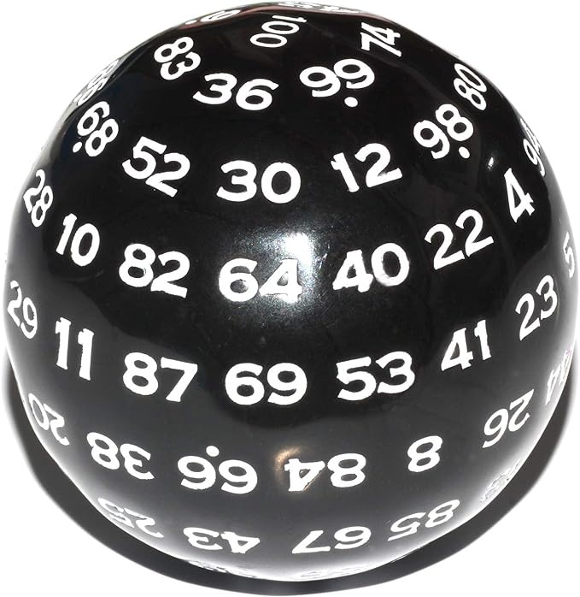
Sampling a word from a distribution
Notes:
It’s simplest to visualize how this works for the unigram case. Imagine all the words of the English language covering the probability space between 0 and 1, each word covering an interval proportional to its frequency. We choose a random value between 0 and 1, find that point on the probability line, and print the word whose interval includes this chosen value. So let's suppose we choose a random number, it's 0.12, we look on our number line, and that's the word "to", so we generate "to" as the next word. We continue choosing random numbers and generating words until we randomly generate the end-of-sentence token.

Slide 57
Visualizing Bigrams the Shannon Way
Choose a random bigram (<s>, w)
according to its probability p(w|<s>)
Now choose a random bigram (w, x) according to its probability p(x|w)
And so on until we choose </s>
Then string the words together
<s> I
I want
want to
to eat
eat Chinese
Chinese food
food </s>
I want to eat Chinese food
Notes:
We can extend this idea to n-grams. For example for the bigram case, we first choose a random bigram whose first token is the start-of-sentence token, according to its probability

Slide 58
Note: there are other sampling methods
Used for neural language models
Many of them avoid generating words from the very unlikely tail of the distribution
We'll discuss when we get to neural LM decoding:
Temperature sampling
Top-k sampling
Top-p sampling
Notes:
There are other, more sophisticated sampling algorithms, that we'll discuss when we get to neural language model decoding, methods like temperature or top-k sampling. They are mainly used to avoid generating really really rare words.

Slide 59
Approximating Shakespeare
Notes:
This figure shows some random sentences generated from unigram, bigram, trigram, and 4- gram models trained on the works of William Shakespeare.
The longer the context, the more coherent the sentences. In these unigram sentences, there's no coherent relation between words. The bigram sentences have some local word-to-word coherence, and sensible punctuation. The 3 and 4-gram sentences are beginning to look a lot like Shakespeare. In fact, they look a little too much like Shakespeare. The words It cannot be but so are directly from King John.

Slide 60
Shakespeare as corpus
N=884,647 tokens, V=29,066
Shakespeare produced 300,000 bigram types out of V²= 844 million possible bigrams.
So 99.96% of the possible bigrams were never seen (have zero entries in the table)
That sparsity is even worse for 4-grams, explaining why our sampling generated actual Shakespeare.
Notes:
Just choosing one author, Shakespeare, makes for a pretty small corpus; under a million words from a vocabulary of 29,000 words. The vocab 29,000 squared is somewhat under a billion. So that means there are a billion possible bigrams whose counts have to come from only a million word corpus, and 10^17 possible 4-grams. So when training on any corpus, the vast majority of all the n-gram counts will be zero!

Slide 61
The Wall Street Journal is not Shakespeare
Notes:
To get an idea of the dependence of a grammar on its training set, let’s look at an n-gram grammar trained on a completely different corpus: the Wall Street Journal (WSJ) newspaper. Shakespeare and the Wall Street Journal are both English, so we might expect some overlap between our n-grams. There is no overlap even in small phrases, let alone entire sentences. Statistical models are use- less as predictors when the training sets and the test sets are as different as Shakespeare and WSJ.

Slide 62
Can you guess the author? These 3-gram sentences are sampled from an LM trained on who?
1) They also point to ninety nine point six billion dollars from two hundred four oh six three percent of the rates of interest stores as Mexico and gram Brazil on market conditions
2) This shall forbid it should be branded, if renown made it empty.
3) “You are uniformly charming!” cried he, with a smile of associating and now and then I bowed and they perceived a chaise and four to wish for.
Notes:
And just to make this absolutely clear, look at these 3 sentences. It should be very clear which one is sampled from the WSJ, which from Shakespeare, and which from Jane Austen.

Slide 63
Choosing training data
If task-specific, use a training corpus that has a similar genre to your task.
If legal or medical, need lots of special-purpose documents
Make sure to cover different kinds of dialects and speaker/authors.
Example: African-American Vernacular English (AAVE)
One of many varieties that can be used by African Americans and others
Can include the auxiliary verb finna that marks immediate future tense:
"My phone finna die"
Notes:
To deal with this problem we should always use a training corpus that has a similar genre to whatever task we are trying to accomplish. To build a language model for translating legal documents, we need a training corpus of legal documents. To build a language model for a question-answering system, we need a training corpus of questions. It is equally important to get training data in the appropriate dialect or variety, especially when processing social media posts or spoken transcripts. For example some tweets will use features of African American English (AAE)— the name for the many varieties of language used in African American communities. Such features can include words like finna—an auxiliary verb that marks immediate future tense.

Slide 64
The perils of overfitting
N-grams only work well for word prediction if the test corpus looks like the training corpus
But even when we try to pick a good training corpus, the test set will surprise us!
We need to train robust models that generalize!
One kind of generalization: Zeros
Things that don’t ever occur in the training set
But occur in the test set
Notes:
In summary, n-grams only work well if the training set is chosen carefully to provide the right kind of language for the test setting. But matching genres and dialects is still not sufficient. Our models may still be subject to the problem of sparsity! Even a good training set might simply be missing some n-grams that appear in the test set.

Slide 65
Zeros
Training set:
… ate lunch
… ate dinner
… ate a
… ate the
P(“breakfast” | ate) = 0
Test set
… ate lunch
… ate breakfast
Notes:
For example, consider a training set that has the phrases "ate lunch", "ate dinner", "ate a", and "ate the", but happens not to have had the phrase "ate breakfast". The P("breakfas|ate) in the test set will be 0!

Slide 66
Zero probability bigrams
Bigrams with zero probability
Will hurt our performance for texts where those words appear!
And mean that we will assign 0 probability to the test set!
And hence we cannot compute perplexity (can’t divide by 0)!
Notes:
These zeros are a problem for two reasons. First, they mean we are underestimating the probability of all sorts of words that might occur, which will hurt the performance of any application we want to run on this data. Second, if the probability of any word in the test set is 0, the entire probability of the test set is 0. And perplexity is based on the inverse probability of the est set. Thus if some words have zero probability, we can’t compute perplexity at all, since we can’t divide by 0! The solution to this problem is called smoothing, and we'll see it in the next lecture!

Slide 67
Language Modeling
Sampling and Generalization
Notes:
In this lecture we've seen how to sample from a language model and how this allows us to talk about how well a language model generalizes (or doesn't) from its training data.

Slide 68
N-gram Language Modeling
Smoothing, Interpolation, and Backoff

Slide 69
The intuition of smoothing (from Dan Klein)
When we have sparse statistics:
Steal probability mass to generalize better
P(w | denied the)
3 allegations
2 reports
1 claims
1 request
7 total
allegations
attack
man
reports
outcome
…
claims
request
P(w | denied the)
2.5 allegations
1.5 reports
0.5 claims
0.5 request
2 other
7 total
allegations
allegations
attack
man
outcome
reports
…
claims
request

Slide 70
Add-one estimation
Also called Laplace smoothing
Pretend we saw each word one more time than we did
Just add one to all the counts!
MLE estimate:
Add-1 estimate:

Slide 71
Maximum Likelihood Estimates
The maximum likelihood estimate
of some parameter of a model M from a training set T
maximizes the likelihood of the training set T given the model M
Suppose the word “bagel” occurs 400 times in a corpus of a million words
What is the probability that a random word from some other text will be “bagel”?
MLE estimate is 400/1,000,000 = .0004
This may be a bad estimate for some other corpus
But it is the estimate that makes it most likely that “bagel” will occur 400 times in a million word corpus.

Slide 72
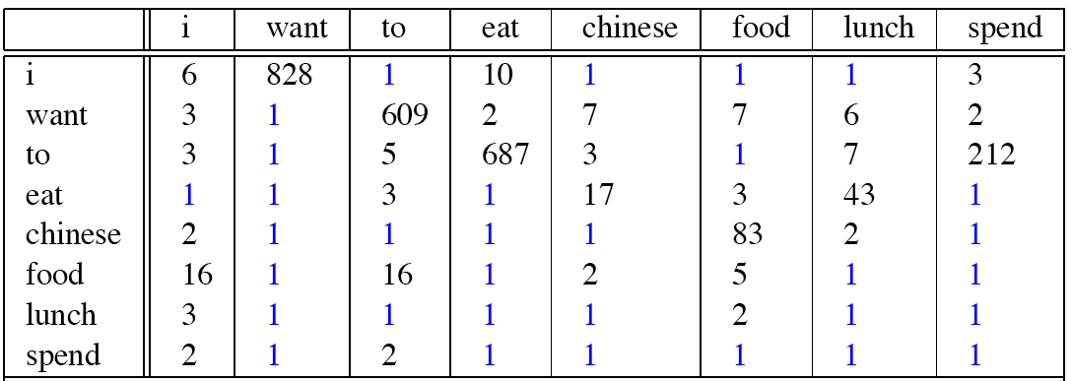
Berkeley Restaurant Corpus: Laplace smoothed bigram counts

Slide 73
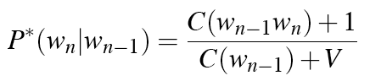
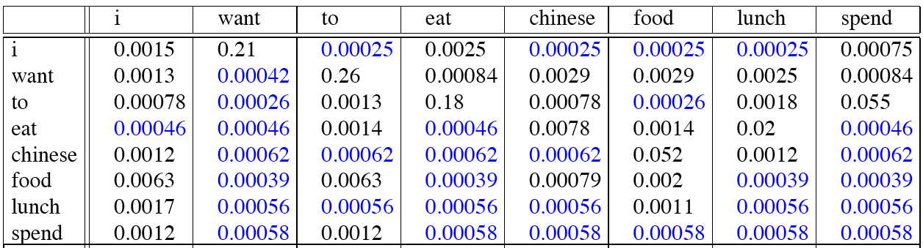
Laplace-smoothed bigrams

Slide 74
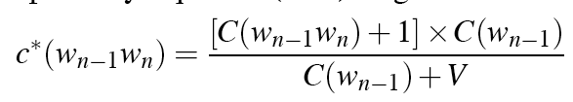
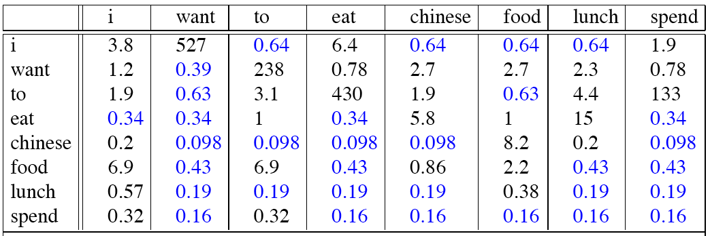
Reconstituted counts

Slide 75
Compare with raw bigram counts
Notes:
C(want to) went from 608 to 238, P(to|want) from .66 to .26!
Discount d= c*/c
d for “chinese food” =.10!!! A 10x reduction

Slide 76
Add-1 estimation is a blunt instrument
So add-1 isn’t used for N-grams:
Generally we use interpolation or backoff instead
But add-1 is used to smooth other NLP models
For text classification
In domains where the number of zeros isn’t so huge.

Slide 77
Backoff and Interpolation
Sometimes it helps to use less context
Condition on less context for contexts you know less about
Backoff:
use trigram if you have good evidence,
otherwise bigram, otherwise unigram
Interpolation:
mix unigram, bigram, trigram
Interpolation works better

Slide 78
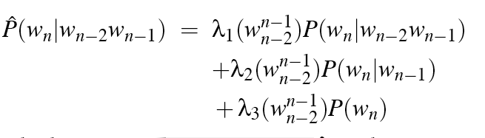
Linear Interpolation
Simple interpolation
Lambdas conditional on context:

Slide 79
How to set λs for interpolation?
Use a held-out corpus
Choose λs to maximize probability of held-out data:
Fix the N-gram probabilities (on the training data)
Then search for λs that give largest probability to held-out set
Training Data
Held-Out Data
Test
Data

Slide 80
Backoff
Suppose you want:
P(pancakes| delicious soufflé)
If the trigram probability is 0, use the bigram
P(pancakes| soufflé)
If the bigram probability is 0, use the unigram
P(pancakes)
Complication: need to discount the higher-order ngram so probabilities don't sum higher than 1 (e.g., Katz backoff)

Slide 81
Stupid Backoff
Backoff without discounting (not a true probability)

Slide 82
N-gram Language Modeling
Interpolation and Backoff

Slide 83
Questions to practice
In a corpus, you found that the word with rank 4th has a frequency of 250. What can be the best guess for the rank of a word with frequency 125?

Slide 84
frequency * rank =k [by Zipfs law]
250*4 = 125*r
r = 8

Slide 85
In the sentence, “In Delhi I took my hat off. But I can’t put it back on.”, total number of word tokens and word types are:

Slide 86
14, 13. Solution: Here, the word “I” is repeated two times so type count is one less than token count.

Slide 87
If first corpus has 𝑇𝑇𝑅1 = 0.06 and second corpus has 𝑇𝑇𝑅2 = 0.105, where 𝑇𝑇𝑅1 and 𝑇𝑇𝑅2 represents type/token ratio in first and second corpus respectively, then

Slide 88
Consider the following corpus C1 of 4 sentences. What is the total count of unique bi-grams for which the likelihood will be estimated? Assume we do not perform any pre-processing.
tomorrow is Sachin’s birthday
He loves cream chocolates
he is also fond of sweet cake
we will celebrate his birthday with sweet chocolate cake
today is Sneha’s birthday
she likes ice cream
she is also fond of cream cake
we will celebrate her birthday with ice cream cake

Slide 89
Solution: Second corpus has more tendency to use different words. If TTR scores are higher then there is more tendency to use different words.

Slide 90
Detailed Solution:
Unique bi-grams are:
<s> tomorrow tomorrow is is Sachin’s Sachin’s birthday birthday <\s>
<s> he he loves loves cream cream chocolates chocolates <\s>
he is is also also fond fond of of sweet
cake <\s>
<s> we we will will celebrate celebrate his
his birthday birthday with with sweet chocolate cake

Slide 91
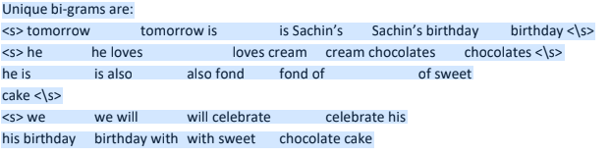

Slide 92
Consider the following corpus C3 of 3 sentences.
there is a big garden
children play in a garden
they play inside beautiful garden
Calculate P(they play in a big garden) assuming a bi-gram language model.

Slide 93
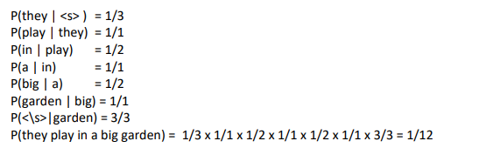

Slide 94
Given a corpus C2, the Maximum Likelihood Estimation (MLE) for the bigram “dried berries” is 0.45 and the count of occurrence of the word “dried” is 720. For the same corpus C2, the likelihood of “dried berries” after applying add-one smoothing is 0.05. What is the vocabulary size of C2?

Slide 95
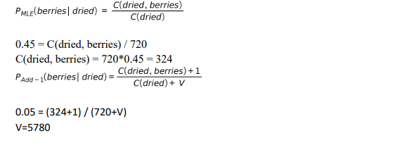

Slide 96
POS TAGGING

Slide 97
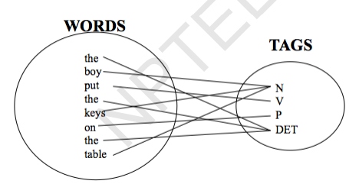
Part-of-Speech (POS) tagging
Task
Given a text of English, identify the parts of speech of each word

Slide 98
Parts of Speech: How many?
Open class words (content words)
nouns, verbs, adjectives, adverbs mostly content-bearing: they refer to objects, actions, and features in the world open class, since new words are added all the time

Slide 99
Closed class words
pronouns, determiners, prepositions, connectives, ... there is a limited number of these mostly functional: to tie the concepts of a sentence together

Slide 100
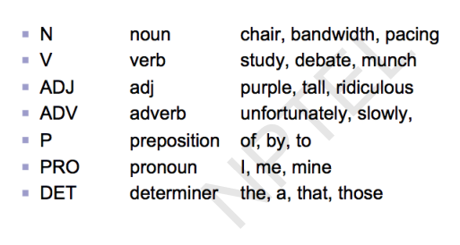

Slide 101
POS tagging: Choosing a tagset
To do POS tagging, a standard set needs to be chosen
Could pick very coarse tagsets N, V, Adj, Adv
More commonly used set is finer grained, “UPenn TreeBank tagset”, 45 tags

Slide 102
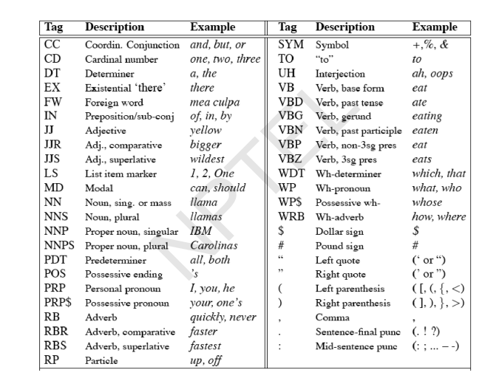
UPenn TreeBank POS tag set

Slide 103
Using the UPenn tagset
Example Sentence
The grand jury commented on a number of other topics.
POS tagged sentence
The/DT grand/JJ jury/NN commmented/VBD on/IN a/DT number/NN of/IN other/JJ topics/NNS ./.

Slide 104
Why is POS tagging hard?
Words often have more than one POS: back
The back door: back/JJ
On my back: back/NN
Win the voters back: back/RB
Promised to back the bill: back/VB
POS tagging problem
To determine the POS tag for a particular instance of a word

Slide 105
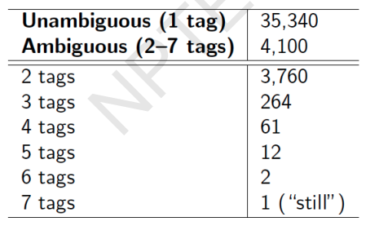
Ambiguous word types in the Brown Corpus
Ambiguity in the Brown corpus 40% of word tokens are ambiguous 12% of word types are ambiguous Breakdown of ambiguous word types:

Slide 106
How bad is the ambiguity problem?
One tag is usually more likely than the others.
In the Brown corpus, race is a noun 98% of the time, and a verb 2% of the time
A tagger for English that simply chooses the most likely tag for each word can achieve good performance
Any new approach should be compared against the unigram baseline (assigning each token to its most likely tag)

Slide 107
Deciding the correct POS
Can be difficult even for people
Mrs./NNP Shaefer/NNP never/RB got/VBD around/RP to/TO joining/VBG.
All/DT we/PRP gotta/VBN do/VB is/VBZ go/VB around/IN the/DT corner/NN.
Chateau/NNP Petrus/NNP costs/VBZ around/RB 2500/CD.

Slide 108
Relevant knowledge for POS tagging
The word itself
Some words may only be nouns, e.g. arrow
Some words are ambiguous, e.g. like, flies
Probabilities may help, if one tag is more likely than another
Local context
Two determiners rarely follow each other
Two base form verbs rarely follow each other
Determiner is almost always followed by adjective or noun

Slide 109
POS tagging: Two approaches
Rule-based Approach
Assign each word in the input a list of potential POS tags
Then winnow down this list to a single tag using hand-written rules
Statistical tagging
Get a training corpus of tagged text, learn the transformation rules from the most frequent tags (TBL tagger)
Probabilistic: Find the most likely sequence of tags T for a sequence of words W

Slide 110
TBL Tagger
Label the training set with most frequent tags
The can was rusted.
The/DT can/MD was/VBD rusted/VBD.
Add transformation rules to reduce training mistakes
MD →NN: DT_
VBD→VBN: VBD_

Slide 111
Probabilistic Tagging: Two different families of models
Problem at hand
We have some data {(d, c)} of paired observations d and hidden classes c.
Different instances of d and c
Part-of-Speech Tagging: words are observed and tags are hidden.
Text Classification: sentences/documents are observed and the
category is hidden.
Categories can be positive/negative for sentiments ..
sports/politics/business for documents ...
What gives rise to the two families?
Whether they generate the observed data from hidden stuff or the hidden structure given the data?

Slide 112
Generative vs. Conditional Models
Generative (Joint) Models
Generate the observed data from hidden stuff, i.e. put a probability over the observations given the class: P(d, c) in terms of P(d|c)
e.g. Naïve Bayes’ classifiers, Hidden Markov Models etc.
Discriminative (Conditional) Models
Take the data as given, and put a probability over hidden structure given the data: P(c|d)
e.g. Logistic regression, maximum entropy models, conditional random fields
SVMs, perceptron, etc. are discriminative classifiers but not directly probabilistic

Slide 113
Joint vs. conditional likelihood
A joint model gives probabilities P(d, c) and tries to maximize this joint likelihood.
A conditional model gives probabilities P(c|d), taking the data as given and modeling only the conditional probability of the class.

Slide 114
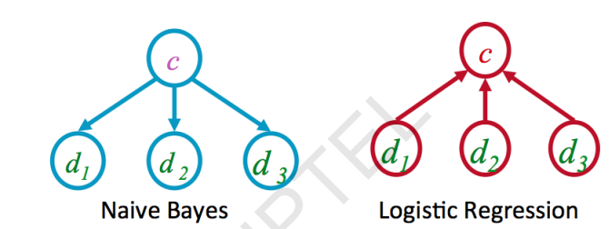

Slide 115
Hidden Markov Models for POS Tagging
Computing the probability values
Tag Transition probabilities

Slide 116
Disambiguating “race”

Slide 117
Difference in probability due to
P(VB/TO) vs. P(NN/TO)
P(race/VB) vs. P(race/NN)
P(NR/VB) vs. P(NR/NN)
After computing the probabilities
P(NN/TO)P(NR/NN)P(race/NN)=0.0047 X 0.0012 X 0.00057=0.00000000032 P(VB/TO)P(NR/VB)P(race/VB)=0.83 X 0.0027 X 0.00012=0.00000027

Slide 118
Hidden Markov Models
Tag Transition probabilities p(ti/ti-1)
Word Likelihood probabilities (emissions) p(wi/ti)
What we have described with these probabilities is a hidden markov
model.
Let us quickly introduce the Markov Chain, or observable Markov Model.

Slide 119
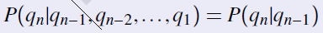
Markov Chain = First-order Markov Model
Weather example
Three types of weather: sunny, rainy, foggy
qn: variable denoting the weather on the nth day
We want to find the following conditional probabilities:
First-order Markov Assumption

Slide 121
Using Markov Chain
Given that today the weather is sunny, what is the probability that tomorrow is sunny and day after is rainy?
P(q2 = sunny;q3 = rainyI q1 = sunny)
= P(q3 = rainyjq2 = sunny;q1 = sunny)P(q2 = sunnyIq1 = sunny)
= P(q3 = rainyjq2 = sunny)P(q2 = sunnyIq1 = sunny)
= 0.05 X 0.8
= 0.04

Slide 122
For Markov chains, the output symbols are the same as the states
‘sunny’ weather is both observable and state
But in POS tagging
The output symbols are words
But the hidden states are POS tags
A Hidden Markov Model is an extension of a Markov chain in which the
output symbols are not the same as the states
We don’t know which state we are in

Slide 123
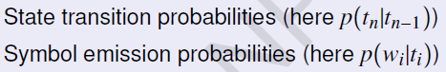
Elements of an HMM model
A set of states (here: the tags)
An output alphabet (here: words)
Initial state (here: beginning of sentence)

Slide 124
Sequence Labeling Problem
Many NLP problems can viewed as sequence labeling.
Each token in a sequence is assigned a label.
Labels of tokens are dependent on the labels of other tokens in the sequence, particularly their neighbors (not i.i.d).
foo bar blam zonk zonk bar blam

Slide 125
Information Extraction
Identify phrases in language that refer to specific types of entities and relations in text.
Named entity recognition is task of identifying names of people, places, organizations, etc. in text.
people organizations places
Michael Dell is the CEO of Dell Computer Corporation and lives in Austin Texas.
Extract pieces of information relevant to a specific application, e.g. used car ads:
make model year mileage price
For sale, 2002 Toyota Prius, 20,000 mi, $15K or best offer. Available starting July 30, 2006.

Slide 126
Semantic Role Labeling
For each clause, determine the semantic role played by each noun phrase that is an argument to the verb.
agent patient source destination instrument
John drove Mary from Austin to Dallas in his Toyota Prius.
The hammer broke the window.
Also referred to a “case role analysis,” “thematic analysis,” and “shallow semantic parsing”

Slide 127
Bioinformatics
Sequence labeling also valuable in labeling genetic sequences in genome analysis.
extron intron
AGCTAACGTTCGATACGGATTACAGCCT

Slide 128
Problems with Sequence Labeling as Classification
Not easy to integrate information from category of tokens on both sides.
Difficult to propagate uncertainty between decisions and “collectively” determine the most likely joint assignment of categories to all of the tokens in a sequence.

Slide 129
Probabilistic Sequence Models
Probabilistic sequence models allow integrating uncertainty over multiple, interdependent classifications and collectively determine the most likely global assignment.
Two standard models
Hidden Markov Model (HMM)
Conditional Random Field (CRF)

Slide 130
Markov Model / Markov Chain
A finite state machine with probabilistic state transitions.
Makes Markov assumption that next state only depends on the current state and independent of previous history.

Slide 131
Sample Markov Model for POS
0.1
Det
Noun
0.95
0.5
0.9
stop
0.05
Verb
0.25
0.1
PropNoun
0.8
0.4
0.5
0.1
0.25
0.1
start

Slide 132
Sample Markov Model for POS
0.1
Det
Noun
0.95
0.5
0.9
stop
0.05
Verb
0.25
0.1
PropNoun
0.8
0.4
0.5
0.1
0.25
0.1
start
P(PropNoun Verb Det Noun) = 0.4*0.8*0.25*0.95*0.1=0.0076

Slide 133
Hidden Markov Model
Probabilistic generative model for sequences.
Assume an underlying set of hidden (unobserved, latent) states in which the model can be (e.g. parts of speech).
Assume probabilistic transitions between states over time (e.g. transition from POS to another POS as sequence is generated).
Assume a probabilistic generation of tokens from states (e.g. words generated for each POS).

Slide 134
Sample HMM for POS
the
cat
0.1
a
the
dog
a
the
car
bed
the
a
apple
that
pen
0.95
0.5
Det
Noun
0.9
bit
saw
stop
0.05
ate
played
Tom
0.25
hit
gave
0.1
John
Verb
Mary
Alice
0.8
0.4
Jerry
0.5
PropNoun
0.1
0.25
0.1
start

Slide 135
Sample HMM Generation
the
cat
0.1
a
the
dog
a
the
car
bed
the
a
apple
that
pen
0.95
0.5
Det
Noun
0.9
bit
saw
stop
0.05
ate
played
Tom
0.25
hit
gave
0.1
John
Verb
Mary
Alice
0.8
0.4
Jerry
0.5
PropNoun
0.1
0.25
0.1
start

Slide 136
Sample HMM Generation
the
cat
0.1
a
the
dog
a
the
car
bed
the
a
apple
that
pen
0.95
0.5
Det
Noun
0.9
bit
saw
stop
0.05
ate
played
Tom
0.25
hit
gave
0.1
John
Verb
Mary
Alice
0.8
0.4
Jerry
0.5
PropNoun
0.1
0.1
start

Slide 137
Sample HMM Generation
the
cat
0.1
a
the
dog
a
the
car
bed
the
a
apple
that
pen
0.95
0.5
Det
Noun
0.9
bit
saw
stop
0.05
ate
played
Tom
0.25
hit
gave
0.1
John
Verb
Mary
Alice
0.8
0.4
Jerry
0.5
PropNoun
0.1
0.25
0.1
start
John

Slide 138
Sample HMM Generation
the
cat
0.1
a
the
dog
a
the
car
bed
the
a
apple
that
pen
0.95
0.5
Det
Noun
0.9
bit
saw
stop
0.05
ate
played
Tom
0.25
hit
gave
0.1
John
Verb
Mary
Alice
0.8
0.4
Jerry
0.5
PropNoun
0.1
0.25
0.1
start
John

Slide 139
Sample HMM Generation
the
cat
0.1
a
the
dog
a
the
car
bed
the
a
apple
that
pen
0.95
0.5
Det
Noun
0.9
bit
saw
stop
0.05
ate
played
Tom
0.25
hit
gave
0.1
John
Verb
Mary
Alice
0.8
0.4
Jerry
0.5
PropNoun
0.1
0.25
0.1
start
John bit

Slide 140
Sample HMM Generation
the
cat
0.1
a
the
dog
a
the
car
bed
the
a
apple
that
pen
0.95
0.5
Det
Noun
0.9
bit
saw
stop
0.05
ate
played
Tom
0.25
hit
gave
0.1
John
Verb
Mary
Alice
0.8
0.4
Jerry
0.5
PropNoun
0.1
0.25
0.1
start
John bit

Slide 141
Sample HMM Generation
the
cat
0.1
a
the
dog
a
the
car
bed
the
a
apple
that
pen
0.95
0.5
Det
Noun
0.9
bit
saw
stop
0.05
ate
played
Tom
0.25
hit
gave
0.1
John
Verb
Mary
Alice
0.8
0.4
Jerry
0.5
PropNoun
0.1
0.25
0.1
start
John bit the

Slide 142
Sample HMM Generation
the
cat
0.1
a
the
dog
a
the
car
bed
the
a
apple
that
pen
0.95
0.5
Det
Noun
0.9
bit
saw
stop
0.05
ate
played
Tom
0.25
hit
gave
0.1
John
Verb
Mary
Alice
0.8
0.4
Jerry
0.5
PropNoun
0.1
0.25
0.1
start
John bit the

Slide 143
Sample HMM Generation
the
cat
0.1
a
the
dog
a
the
car
bed
the
a
apple
that
pen
0.95
0.5
Det
Noun
0.9
bit
saw
stop
0.05
ate
played
Tom
0.25
hit
gave
0.1
John
Verb
Mary
Alice
0.8
0.4
Jerry
0.5
PropNoun
0.1
0.25
0.1
start
John bit the apple

Slide 144
Sample HMM Generation
the
cat
0.1
a
the
dog
a
the
car
bed
the
a
apple
that
pen
0.95
0.5
Det
Noun
0.9
bit
saw
stop
0.05
ate
played
Tom
0.25
hit
gave
0.1
John
Verb
Mary
Alice
0.8
0.4
Jerry
0.5
PropNoun
0.1
0.25
0.1
start
John bit the apple

Slide 145
Formal Definition of an HMM
A set of N +2 states S={s₀,s₁,s₂, … s_{N,} s_{F}}
Distinguished start state: s₀
Distinguished final state: s_{F}
A set of M possible observations V={v₁,v₂…v_{M}}
A state transition probability distribution A={a_{ij}}
Observation probability distribution for each state j B={b_{j}(k)}
Total parameter set λ={A,B}

Slide 146
HMM Generation Procedure
To generate a sequence of T observations: O = o₁ o₂ … o_{T}
Set initial state q₁=s₀
For t = 1 to T
Transit to another state q_{t+1}=s_{j} based on transition
distribution a_{ij} for state q_{t}
Pick an observation o_{t}=v_{k} based on being in state q_{t} using
distribution b_{qt}(k)

Slide 147
Three Useful HMM Tasks
Observation Likelihood: To classify and order sequences.
Most likely state sequence (Decoding): To tag each token in a sequence with a label.
Maximum likelihood training (Learning): To train models to fit empirical training data.

Slide 148
HMM: Observation Likelihood
Given a sequence of observations, O, and a model with a set of parameters, λ, what is the probability that this observation was generated by this model: P(O| λ) ?
Allows HMM to be used as a language model: A formal probabilistic model of a language that assigns a probability to each string saying how likely that string was to have been generated by the language.
Useful for two tasks:
Sequence Classification
Most Likely Sequence

Slide 149
Sequence Classification
Assume an HMM is available for each category (i.e. language).
What is the most likely category for a given observation sequence, i.e. which category’s HMM is most likely to have generated it?
Used in speech recognition to find most likely word model to have generate a given sound or phoneme sequence.
O
ah s t e n
?
?
Austin
P(O | Austin) > P(O | Boston) ?
Boston

Slide 150
Most Likely Sequence
Of two or more possible sequences, which one was most likely generated by a given model?
Used to score alternative word sequence interpretations in speech recognition.
O₁
?
dice precedent core
?
vice president Gore
O₂
Ordinary English
P(O₂ | OrdEnglish) > P(O₁ | OrdEnglish) ?

Slide 151
HMM: Observation Likelihood Naïve Solution
Consider all possible state sequences, Q, of length T that the model could have traversed in generating the given observation sequence.
Compute the probability of a given state sequence from A, and multiply it by the probabilities of generating each of given observations in each of the corresponding states in this sequence to get P(O,Q| λ) = P(O| Q, λ) P(Q| λ) .
Sum this over all possible state sequences to get P(O| λ).
Computationally complex: O(TN^{T}).

Slide 152
HMM: Observation Likelihood Efficient Solution
Due to the Markov assumption, the probability of being in any state at any given time t only relies on the probability of being in each of the possible states at time t−1.
Forward Algorithm: Uses dynamic programming to exploit this fact to efficiently compute observation likelihood in O(TN²) time.
Compute a forward trellis that compactly and implicitly encodes information about all possible state paths.

Slide 153
Forward Trellis
s₁
• • •
s₂
• • •
•
•
•
•
•
•
•
•
•
•
•
•
•
•
•
s₀
• • •
s_{F}
s_{N}
• • •
t₁
t₂
t₃
t_{T-1}
t_{T}
Continue forward in time until reaching final time point and sum probability of ending in final state.

Slide 154
Forward Probabilities
Let α_{t}(j) be the probability of being in state j after seeing the first t observations (by summing over all initial paths leading to j).

Slide 155
Forward Step
Consider all possible ways of getting to s_{j} at time t by coming from all possible states s_{i} and determine probability of each.
Sum these to get the total probability of being in state s_{j} at time t while accounting for the first t −1 observations.
Then multiply by the probability of actually observing o_{t} in s_{j.}
s₁
a_{1j}
s₂
a_{2j}
•
•
•
a_{2j}
s_{j}
a_{Nj}
s_{N}
α_{t-1}(i)
α_{t}(i)

Slide 156
Computing the Forward Probabilities
Initialization
Recursion
Termination

Slide 157
Forward Computational Complexity
Requires only O(TN²) time to compute the probability of an observed sequence given a model.
Exploits the fact that all state sequences must merge into one of the N possible states at any point in time and the Markov assumption that only the last state effects the next one.

Slide 158
Most Likely State Sequence (Decoding)
Given an observation sequence, O, and a model, λ, what is the most likely state sequence,Q=q₁,q₂,…q_{T}, that generated this sequence from this model?
Used for sequence labeling, assuming each state corresponds to a tag, it determines the globally best assignment of tags to all tokens in a sequence using a principled approach grounded in probability theory.
John gave the dog an apple.

Slide 159
Most Likely State Sequence
Given an observation sequence, O, and a model, λ, what is the most likely state sequence,Q=q₁,q₂,…q_{T}, that generated this sequence from this model?
Used for sequence labeling, assuming each state corresponds to a tag, it determines the globally best assignment of tags to all tokens in a sequence using a principled approach grounded in probability theory.
John gave the dog an apple.
Det Noun PropNoun Verb

Slide 160
Most Likely State Sequence
Given an observation sequence, O, and a model, λ, what is the most likely state sequence,Q=q₁,q₂,…q_{T}, that generated this sequence from this model?
Used for sequence labeling, assuming each state corresponds to a tag, it determines the globally best assignment of tags to all tokens in a sequence using a principled approach grounded in probability theory.
John gave the dog an apple.
Det Noun PropNoun Verb

Slide 161
Most Likely State Sequence
Given an observation sequence, O, and a model, λ, what is the most likely state sequence,Q=q₁,q₂,…q_{T}, that generated this sequence from this model?
Used for sequence labeling, assuming each state corresponds to a tag, it determines the globally best assignment of tags to all tokens in a sequence using a principled approach grounded in probability theory.
John gave the dog an apple.
Det Noun PropNoun Verb

Slide 162
Most Likely State Sequence
Given an observation sequence, O, and a model, λ, what is the most likely state sequence,Q=q₁,q₂,…q_{T}, that generated this sequence from this model?
Used for sequence labeling, assuming each state corresponds to a tag, it determines the globally best assignment of tags to all tokens in a sequence using a principled approach grounded in probability theory.
John gave the dog an apple.
Det Noun PropNoun Verb

Slide 163
Most Likely State Sequence
Given an observation sequence, O, and a model, λ, what is the most likely state sequence,Q=q₁,q₂,…q_{T}, that generated this sequence from this model?
Used for sequence labeling, assuming each state corresponds to a tag, it determines the globally best assignment of tags to all tokens in a sequence using a principled approach grounded in probability theory.
John gave the dog an apple.
Det Noun PropNoun Verb

Slide 164
Most Likely State Sequence
Given an observation sequence, O, and a model, λ, what is the most likely state sequence,Q=q₁,q₂,…q_{T}, that generated this sequence from this model?
Used for sequence labeling, assuming each state corresponds to a tag, it determines the globally best assignment of tags to all tokens in a sequence using a principled approach grounded in probability theory.
John gave the dog an apple.
Det Noun PropNoun Verb

Slide 165
HMM: Most Likely State Sequence Efficient Solution
Obviously, could use naïve algorithm based on examining every possible state sequence of length T.
Dynamic Programming can also be used to exploit the Markov assumption and efficiently determine the most likely state sequence for a given observation and model.
Standard procedure is called the Viterbi algorithm (Viterbi, 1967) and also has O(N²T) time complexity.

Slide 166
Viterbi Scores
Recursively compute the probability of the most likely subsequence of states that accounts for the first t observations and ends in state s_{j}.
Also record “backpointers” that subsequently allow backtracing the most probable state sequence.
bt_{t}(j) stores the state at time t-1 that maximizes the probability that system was in state s_{j} at time t (given the observed sequence).

Slide 167
Computing the Viterbi Scores
Initialization
Recursion
Termination
Analogous to Forward algorithm except take max instead of sum

Slide 168
Computing the Viterbi Backpointers
Initialization
Recursion
Termination
Final state in the most probable state sequence. Follow
backpointers to initial state to construct full sequence.

Slide 169
Viterbi Decoding for HMM, Parameter Learning
POS Tagging
Week 4, Lecture 1

Slide 170
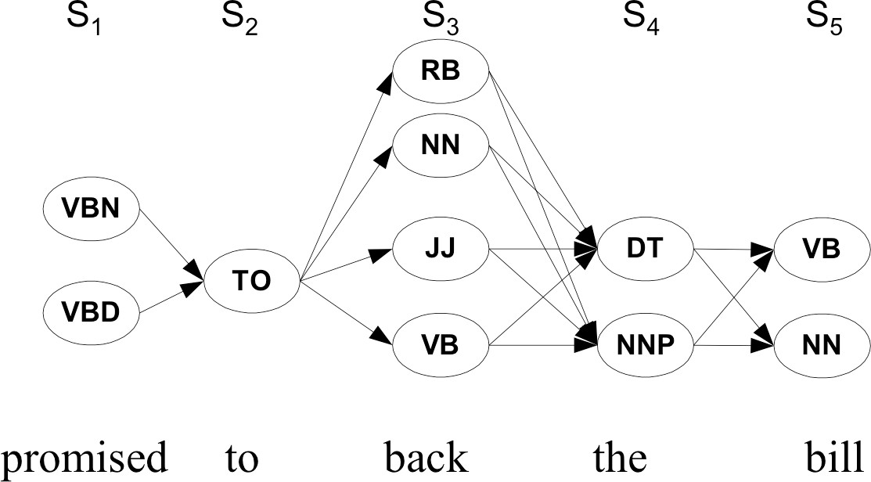
Walking through the states: best path
POS Tagging
Week 4, Lecture 1

Slide 171
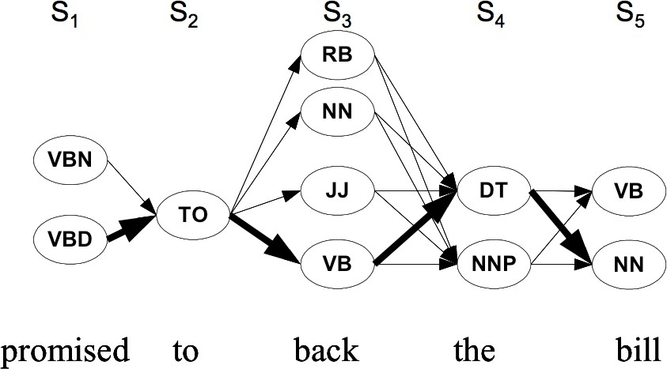
Walking through the states: best path
POS Tagging
Week 4, Lecture 1

Slide 172
Finding the best path: Viterbi Algorithm
Intuition
Optimal path for each state can be recorded. We need
Cheapest cost to state j at step s: δ_{j}(s)
Backtrace from that state to best predecessor ψ_{j}(s)
POS Tagging
Week 4, Lecture 1
4 / 6

Slide 173
Finding the best path: Viterbi Algorithm
Intuition
Optimal path for each state can be recorded. We need
Cheapest cost to state j at step s: δ_{j}(s)
Backtrace from that state to best predecessor ψ_{j}(s)
Computing these values
δ_{j}(s + 1) = max_{1≤i≤N} δ_{i}(s)p(t_{j}|t_{i})p(w_{s+1}|t_{j})
POS Tagging
Week 4, Lecture 1
4 / 6

Slide 174
Finding the best path: Viterbi Algorithm
Intuition
Optimal path for each state can be recorded. We need
Cheapest cost to state j at step s: δ_{j}(s)
Backtrace from that state to best predecessor ψ_{j}(s)
Computing these values
δ_{j}(s + 1) = max_{1≤i≤N} δ_{i}(s)p(t_{j}|t_{i})p(w_{s+1}|t_{j}) ψ_{j}(s + 1) = argmax_{1≤i≤N} δ_{i}(s)p(t_{j}|t_{i})p(w_{s+1}|t_{j})
POS Tagging
Week 4, Lecture 1
4 / 6

Slide 175
Finding the best path: Viterbi Algorithm
Intuition
Optimal path for each state can be recorded. We need
Cheapest cost to state j at step s: δ_{j}(s)
Backtrace from that state to best predecessor ψ_{j}(s)
Computing these values
δ_{j}(s + 1) = max_{1≤i≤N} δ_{i}(s)p(t_{j}|t_{i})p(w_{s+1}|t_{j}) ψ_{j}(s + 1) = argmax_{1≤i≤N} δ_{i}(s)p(t_{j}|t_{i})p(w_{s+1}|t_{j})
Best final state is argmax_{1≤i≤N} δ_{i}(|S|), we can backtrack from there
POS Tagging
Week 4, Lecture 1
4 / 6

Slide 176
Practice Question
Suppose you want to use a HMM tagger to tag the phrase, “the light book”, where we have the following probabilities:
P(the|Det) = 0.3, P(the|Noun) = 0.1, P(light|Noun) = 0.003, P(light|Adj) = 0.002, P(light|Verb) = 0.06, P(book|Noun) = 0.003, P(book|Verb) = 0.01
P(Verb|Det) = 0.00001, P(Noun|Det) = 0.5, P(Adj|Det) = 0.3,
P(Noun|Noun) =0.2, P(Adj|Noun) = 0.002, P(Noun|Adj) = 0.2,
P(Noun|Verb) = 0.3, P(Verb|Noun) = 0.3, P(Verb|Adj) = 0.001,
P(Verb|Verb) = 0.1
Work out in details the steps of the Viterbi algorithm. You can use a Table to show the steps. Assume all other conditional probabilities, not mentioned to be zero. Also, assume that all tags have the same probabilities to appear in the beginning of a sentence.
POS Tagging
Week 4, Lecture 1

Slide 177
Learning the Parameters
Two Scenarios
A labeled dataset is available, with the POS category of individual words in a corpus
Only the corpus is available, but not labeled with the POS categories
POS Tagging
Week 4, Lecture 1
6 / 6

Slide 178
Learning the Parameters
Two Scenarios
A labeled dataset is available, with the POS category of individual words in a corpus
Only the corpus is available, but not labeled with the POS categories
Methods for these scenarios
For the first scenario, parameters can be directly estimated using maximum likelihood estimate from the labeled dataset
For the second scenario, Baum-Welch Algorithm is used to estimate the parameters of the hidden markov model.
POS Tagging
Week 4, Lecture 1
6 / 6

Slide 179
Baum Welch Algorithm
POS Tagging
Week 4, Lecture 2

Slide 180
Baum Welch Algorithm
Uses the well-known EM algorithm to find the maximum likelihood estimate of the parameters of a hidden markov model
POS Tagging
Week 4, Lecture 2
2 / 6

Slide 181
Baum Welch Algorithm
Uses the well-known EM algorithm to find the maximum likelihood estimate of the parameters of a hidden markov model
Parameters of HMM
Let X_{t} be the random variable denoting hidden state at time t, and Y_{t} be the observation variable at time T. HMM parameters are given by θ = (A, B, π) where
A = {a_{ij}} = P(X_{t} = j|X_{t−1} = i) is the state transition matrix
π = {π_{i}} = P(X₁ = i) is the initial state distribution
B = {b_{j}(y_{t})} = P(Y_{t} = y_{t}|X_{t} = j) is the emission matrix
POS Tagging
Week 4, Lecture 2
2 / 6

Slide 182
Baum Welch Algorithm
Uses the well-known EM algorithm to find the maximum likelihood estimate of the parameters of a hidden markov model
Parameters of HMM
Let X_{t} be the random variable denoting hidden state at time t, and Y_{t} be the observation variable at time T. HMM parameters are given by θ = (A, B, π) where
A = {a_{ij}} = P(X_{t} = j|X_{t−1} = i) is the state transition matrix
π = {π_{i}} = P(X₁ = i) is the initial state distribution
B = {b_{j}(y_{t})} = P(Y_{t} = y_{t}|X_{t} = j) is the emission matrix
Given observation sequences Y = (Y₁ = y₁, Y₂ = y₂, . . . , Y_{T} = y_{T} ), the algorithm tries to find the parameters θ that maximise the probability of the observation.
POS Tagging
Week 4, Lecture 2
2 / 6

Slide 183
The Algorithm
The basic idea is to start with some random initial conditions on the parameters θ, estimate best values of state paths X_{t} using these, then
re-estimate the parameters θ using the just-computed values of X_{t}, iteratively.
POS Tagging
Week 4, Lecture 2
3 / 6

Slide 184
The Algorithm
The basic idea is to start with some random initial conditions on the parameters θ, estimate best values of state paths X_{t} using these, then
re-estimate the parameters θ using the just-computed values of X_{t}, iteratively.
Intuition
Choose some initial values for θ = (A, B, π).
Repeat the following step until convergence:
Determine probable (state) paths . . . X_{t−1} = i, X_{t} = j . . .
Count the expected number of transitions a_{ij} as well as the expected number of times, various emissions b_{j}(y_{t}) are made
Re-estimate θ = (A, B, π) using a_{ij} and b_{j}(y_{t})s.
A forward-backward algorithm is used for finding probable paths.
POS Tagging
Week 4, Lecture 2
3 / 6

Slide 185
Forward-Backward Algorithm
Forward Procedure
α_{i}(t) = P(Y₁ = y₁, . . . , Y_{t} = y_{t}, X_{t} = i|θ) be the probability of seeing y₁, . . . , y_{t}
and being in state i at time t. Found recursively using:
α_{i}(1) = π_{i}b_{i}(y₁)
POS Tagging
Week 4, Lecture 2
4 / 6

Slide 186
Forward-Backward Algorithm
Forward Procedure
α_{i}(t) = P(Y₁ = y₁, . . . , Y_{t} = y_{t}, X_{t} = i|θ) be the probability of seeing y₁, . . . , y_{t}
and being in state i at time t. Found recursively using:
α_{i}(1) = π_{i}b_{i}(y₁)
N
X
α (t + 1) = b (y ) α (t)a
j j t+1 i ij
i=1
POS Tagging
Week 4, Lecture 2
4 / 6

Slide 187
Forward-Backward Algorithm
Forward Procedure
α_{i}(t) = P(Y₁ = y₁, . . . , Y_{t} = y_{t}, X_{t} = i|θ) be the probability of seeing y₁, . . . , y_{t}
and being in state i at time t. Found recursively using:
α_{i}(1) = π_{i}b_{i}(y₁)
N
X
α (t + 1) = b (y ) α (t)a
j j t+1 i ij
i=1
Backward Procedure
β_{i}(t) = P(Y_{t+1} = y_{t+1},..., Y_{T} = y_{T} |X_{t} = i, θ) be the probability of ending partial sequence y_{t+1},..., y_{T} given starting state i at time t. β_{i}(t) is computed recursively as:
β_{i}(T) = 1
POS Tagging
Week 4, Lecture 2
4 / 6

Slide 188
Forward-Backward Algorithm
Forward Procedure
α_{i}(t) = P(Y₁ = y₁, . . . , Y_{t} = y_{t}, X_{t} = i|θ) be the probability of seeing y₁, . . . , y_{t}
and being in state i at time t. Found recursively using:
α_{i}(1) = π_{i}b_{i}(y₁)
N
X
α (t + 1) = b (y ) α (t)a
j j t+1 i ij
i=1
Backward Procedure
β_{i}(t) = P(Y_{t+1} = y_{t+1},..., Y_{T} = y_{T} |X_{t} = i, θ) be the probability of ending partial
sequence y_{t+1},..., y_{T} given starting state i at time t. β_{i}(t) is computed recursively as:
β_{i}(T) = 1
N
X
β (t) = β
(t + 1)a_{ij}b_{j}(y_{t+1})
i j
j=1
POS Tagging
Week 4, Lecture 2
4 / 6

Slide 189
Finding probabilities of paths
We compute the following variables:
Probability of being in state i at time t given the observation Y and parameters θ
α_{i}(t)β_{i}(t)
γ_{i}(t) = P(X_{t} = i|Y, θ) =
.
N
α_{j}(t)β_{j}(t)
j=1
Probability of being in state i and j at time t and t + 1 respectively given the observation Y and parameters θ
α_{i}(t)a_{ij}β_{j}(t + 1)b_{j}(y_{t+1})
ζ (t) = P
(X = i, X
= j|Y, θ) =
. .
ij
t
t+1
N N
α_{i}(t)a_{ij}β_{j}(t + 1)b_{j}(y_{t+1})
i=1 j=1
POS Tagging
Week 4, Lecture 2

Slide 190
Updating the parameters
π_{i} = γ_{i}(1), expected number of times state i was seen at time 1
.
T
ζij(t)
a = . _{γ (t)} , expected number of transitions from state i to state j,
ij T
t=1
t=1 ^{i}
compared to the total number of transitions away from state i
.
T
b_{i}(v_{k}) = .
1y_{t} =v γi(t)
with 1_{yt =vk} being an indicator function, is the
t=1 k
T
γi(t)
t=1
expected number of times the output observations are v_{k} while being in state i compared to the expected total number of times in state i.
POS Tagging
Week 4, Lecture 2

